Slide 1
Intern Innovation Challenge:
A lesson on networking
Team Gotta Cache’em All
Dale Whinham, Alex Gilday, Gaetan Bahl
Cambridge
2016

Slide 2

The team
Dale Whinham
  Professional VIM user
Alex Gilday
  #MyLinuxIsBroken #hashtag
Gaetan Bahl
  “I have 4 ARM t-shirts”

Slide 3
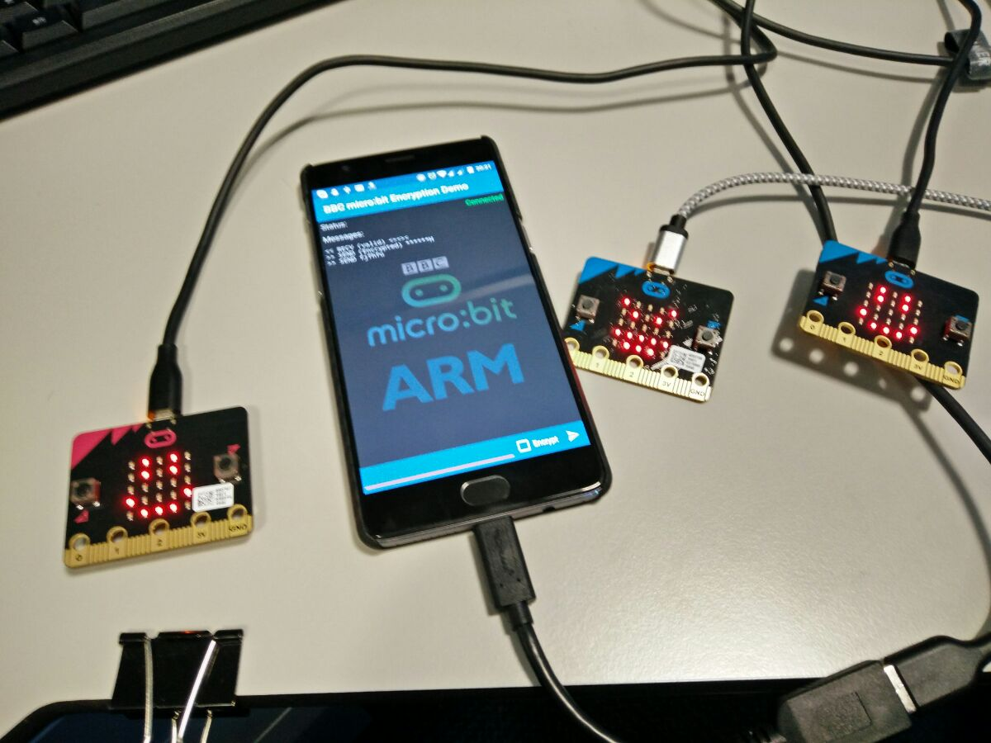
Introduction
Small lesson on networking
Target audience: High school pupils
Hardware:
  Three micro:bits
  Two phones/laptops
  (Optional) third phone/laptop

Slide 4


Ash and Misty

Slide 5
How to communicate?

Slide 6

Use the PokéNav’s built-in radio!

Slide 7
But what happens if Team Rocket
also has a PokéNav ?

Slide 8

Team Rocket can spy on Ash and Misty!

Slide 9
What can we do to stop them?

Slide 10

Use encryption!
Create a secret handshake
Encrypt the messages using that handshake
Tadaaa: Only the ones who know the handshake can read the messages!

Slide 11



Team Rocket can’t read the messages anymore!

Slide 12

What does this teach us?
You never know who might be reading your information when using a non-secure connection
Look for the little padlock in the address bar of your browser – that means the connection is encrypted!
Do not use unsecured wireless networks
Use strong passwords

Slide 13
“Think Security”
- Random ARM poster -

Slide 14
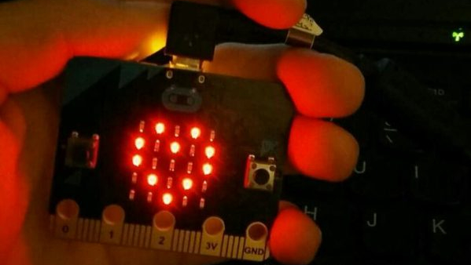
Thank you!

